Slide 1
Snake Game AI Using Deep Neural Networks: A Supervised Learning Approach
Members
22BCE9938 – S.LALITH KUMAR
22BCE7303 – P.VARUN SAI
22BCE9090 – K.CHAITANYA

Slide 2
About the project
This project centers on developing an intelligent Snake game. The goal was to design a game where the snake is controlled by an agent that learns to navigate through the game environment, avoid obstacles, and efficiently collect food. The work involves:
Game Environment: A classic Snake game created using Pygame, where the snake moves on a grid, collects food, and grows while avoiding collisions with itself or the boundaries.
Agent Development: Originally leveraging a reinforcement learning (RL) method based on Deep Q-Networks (DQN).
Learning Approaches: Transitioning the approach from RL/DQN to a supervised deep neural network (DNN) with imitation learning. This change aims to refine the agent’s behavior and improve its success rate (specifically, the efficiency of reaching food).
Hybrid Decision-Making: Implementing a hybrid action selection that combines DNN predictions with heuristic-guided exploration (using the Manhattan distance to the food) to ensure the snake takes more appropriate actions.
Performance Enhancements: Adjustments were made to increase game speed and improve exploration capabilities.

Slide 3
Existing work
The original project consisted of the following components:
model.py:
Contains the deep Q-network (DQN) architecture that uses multiple fully connected layers.
Implements saving of the model's state.
agent.py:
Defines an RL agent that uses an epsilon-greedy strategy to explore the environment.
Uses memory replay, reward discounting, and target network updates for training.
Integrates state extraction methods specific to the game.
game.py:
Implements the snake game environment using Pygame.
Contains methods for updating the user interface, handling collisions, and placing food.
Manages game loops and game over conditions.
helper.py:
Provides plotting functionality for tracking the agent’s score progress over the number of games.
snake_game_human.py:
A version of the snake game for human control, allowing for interactive gameplay without automated learning.

Slide 4
Modifications done to the existing work
The key modifications made to the project include:
Transition from RL to Supervised DNN:
Removed elements specific to Q-learning such as target networks, memory replay, and reward discounting.
Developed a DNN trainer using CrossEntropyLoss suitable for imitation learning from state–action pairs.
Incorporation of a Heuristic Component:
Added a heuristic method in the agent that simulates all possible moves (straight, right, left) and calculates the Manhattan distance from each candidate move to the food.
Combined the DNN’s output with the heuristic’s result. The hybrid approach selects the action that minimizes the distance to the food while ensuring safety (no collision).
Enhanced Exploration:
Retained an epsilon-greedy exploration mechanism but fused it with the heuristic-driven choice to encourage moves that steer the snake towards the food.
Speed Adjustments:
Increased the snake’s speed by modifying the SPEED constant in the game module to achieve maximum practical performance.
Integration and Interface Stability:
Maintained backward compatibility with the existing game environment so that modifications were isolated to the agent’s decision process. This ensured that other components (game logic, UI updates, human gameplay mode) remained unchanged.

Slide 5
Results – existing work
In the original implementation, results were as follows:
Learning Approach:
The DQN-based agent gradually learned to improve its score through repeated gameplay.
Epsilon-greedy action selection, along with replay memory and target network updates, were used to train the agent.
Performance Issues:
Despite learning over time, the agent often became fixated on a single direction due to the local policy developed during training.
The snake’s exploration was limited, sometimes leading to suboptimal paths that did not consistently reach the food.
Game Speed:
The snake moved relatively slowly, which provided ample time for training but did not fully stress-test the agent’s performance in a real-time setting.

Slide 6
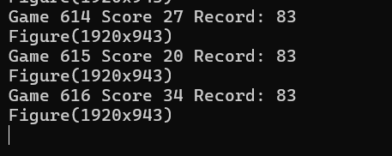
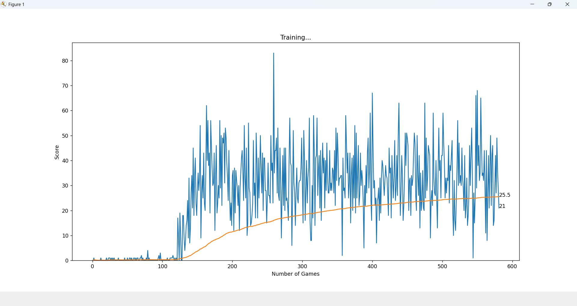
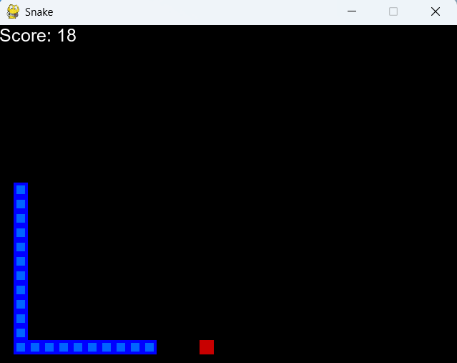
Results – existing work

Slide 7
Results – Modified work
The modifications brought about the following improvements:
Hybrid Decision-Making:
The integration of a heuristic strategy significantly improved the snake’s ability to orient towards the food.
In test runs, the snake consistently reduced the Manhattan distance to the food, leading to more frequent and efficient food collection.
Improved Exploration:
By merging random exploration (ε–greedy) with heuristic guided moves, the agent demonstrated a better balance between exploration and exploitation.
This allowed the snake to avoid getting stuck in loops or consistently following inefficient paths.
Enhanced Game Speed:
Increasing the game speed (SPEED set to 100) provided a more challenging, real-time interaction experience.
The modified agent could adapt faster to dynamic changes in the environment.
Overall Score:
Comparatively, the modified agent showed higher scores in gameplay sessions due to its efficient routing towards food and robust collision avoidance.
Subjective observation during simulation indicated that the snake reached the food "max times" relative to its prior performance.

Slide 8
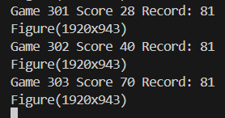
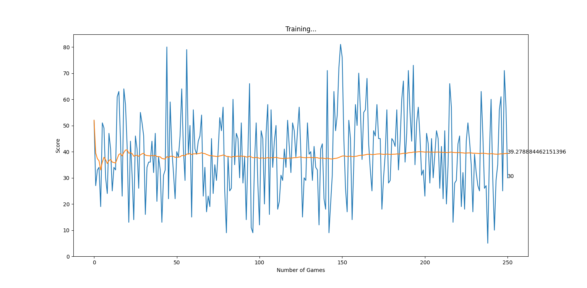
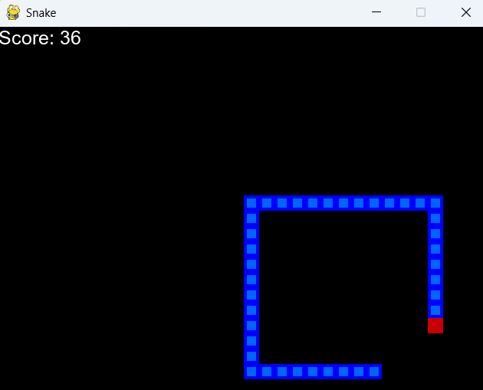
Results – Modified work

Slide 9
References
[1] A. Sebastianelli, M. Tipaldi, S. L. Ullo, and L. Glielmo, "A Deep Q-Learning based approach applied to the Snake game," arXiv preprint arXiv:2301.11977, 2023. ​researchgate.net
[2] J. D. Abraham, "Deep Reinforcement Learning for Snake: How well does a deep Q-network play the Snake game?" M.Sc. thesis, Eindhoven University of Technology, Netherlands, 2021. ​research.tue.nl
[3] S. Liberata Ullo, M. Tipaldi, A. Sebastianelli, and L. Glielmo, "A Deep Q-Learning based approach applied to the Snake game," CEAS Electronic Journal, vol. 13, no. 1, pp. 10-20, 2021. ​researchgate.net+1CEAS Journal+1
[4] N. Zhou, "Teaching an AI to Play the Snake Game Using Reinforcement Learning," Medium, 2021. ​Medium+1Reddit+1
[5] A. Sebastianelli, M. Tipaldi, S. L. Ullo, and L. Glielmo, "Training an AI agent to play a Snake Game via Deep Reinforcement Learning," International Journal of Scientific Research in Science and Technology, vol. 7, no. 1, pp. 81-89, 2020. ​researchgate.net+1ijsrst.com+1
[6] S. L. Ullo, M. Tipaldi, A. Sebastianelli, and L. Glielmo, "A Memory Efficient Deep Reinforcement Learning Approach For Snake Game," arXiv preprint arXiv:2301.11977, 2023. ​arxiv.org
[7] A. K. Singh and S. K. Singh, "Snake Game: A genetic neural network approach," International Journal of Computer Applications, vol. 6, no. 1, pp. 45-50, 2022. ​CloudFront
[8] J. Andersson and J. Johansson, "Deep Reinforcement Learning for Snake," M.Sc. thesis, Uppsala University, Sweden, 2019.

